Slide 1
Chinese film industry-2017
Color tone vs grade
Tian Wang
2018.12.4

Slide 2
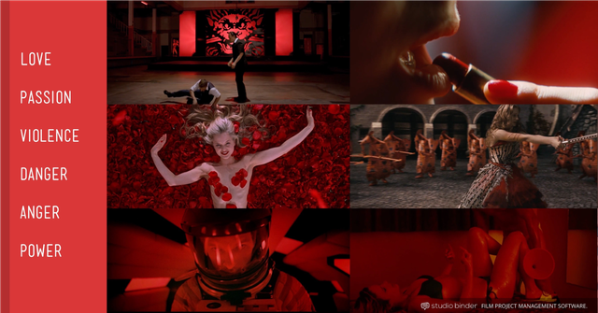
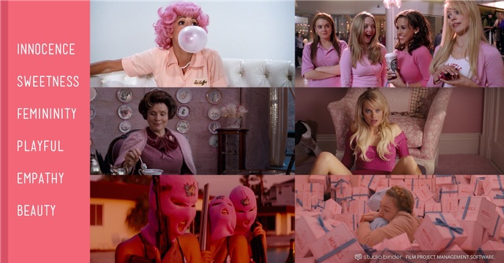
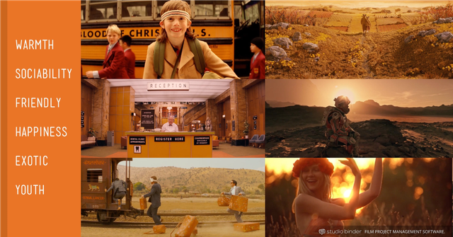
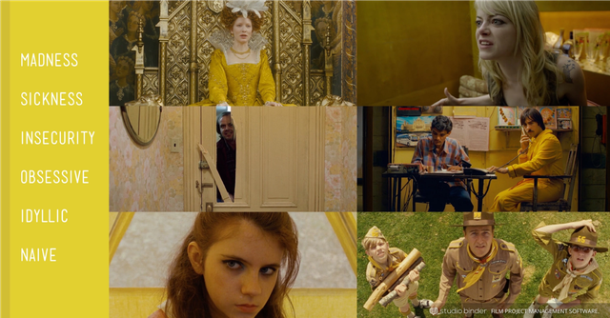
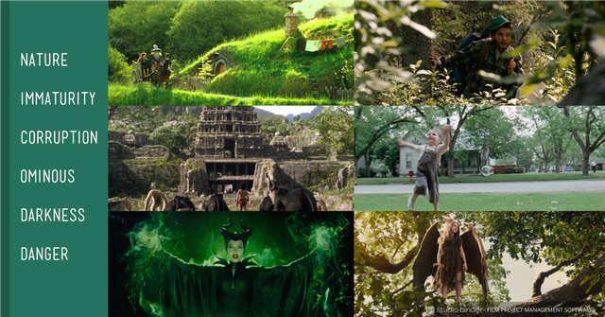
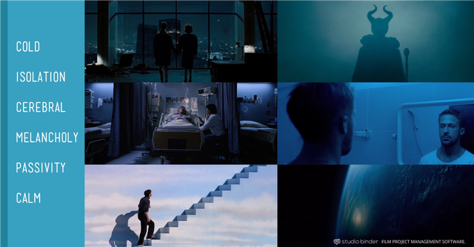
Introduction
The idea of this project is to explore the relationship between film color-tone and its ranking. Films are cultural artifacts created by specific cultures. In this project, the topic concentrated on Chinese film industry in year of 2017. Film is a source of entertainment, but it is more a form art. Art can affect people in a psychological way. Just as the picture shows at right, films affect people not only because of the story it told, but also, how the post production processed. If ranks do have a strong relationship with color-tone, then the productors of films could modulate the color tone of films into the best attractive tone. Then eventually, the box-office will be affected.

Slide 3
Mosaic of films in 2017

Slide 4
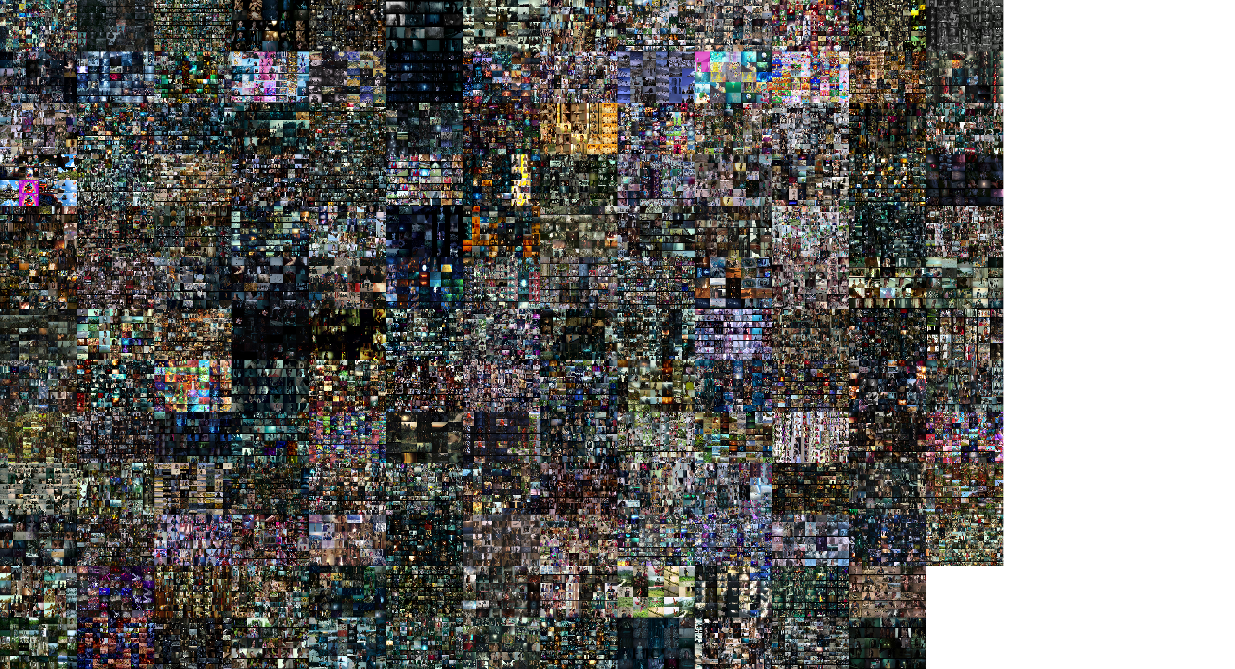

Slide 5
Some particular examples

Slide 6
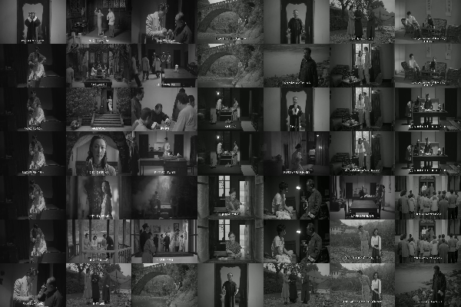
A grey-tone film.

Slide 7
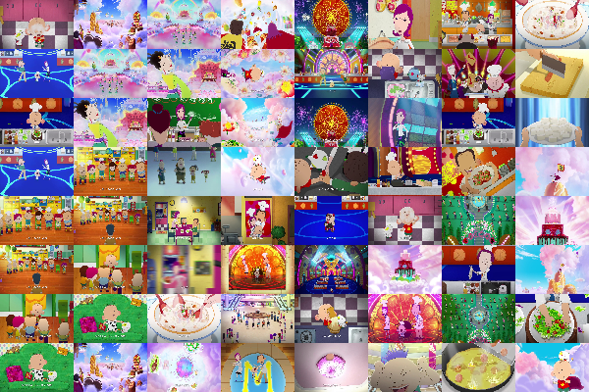
A pinky-tone film

Slide 8
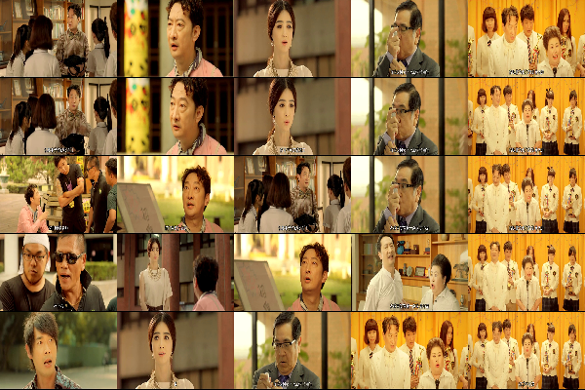
A yellow-tone film

Slide 9
Build Crawlers
Packages used:
re, urllib, BeautifulSoup, requests, pandas
Resource website:
https://maoyan.com/
Attention:
Use user-agent and time.sleep()

Slide 10
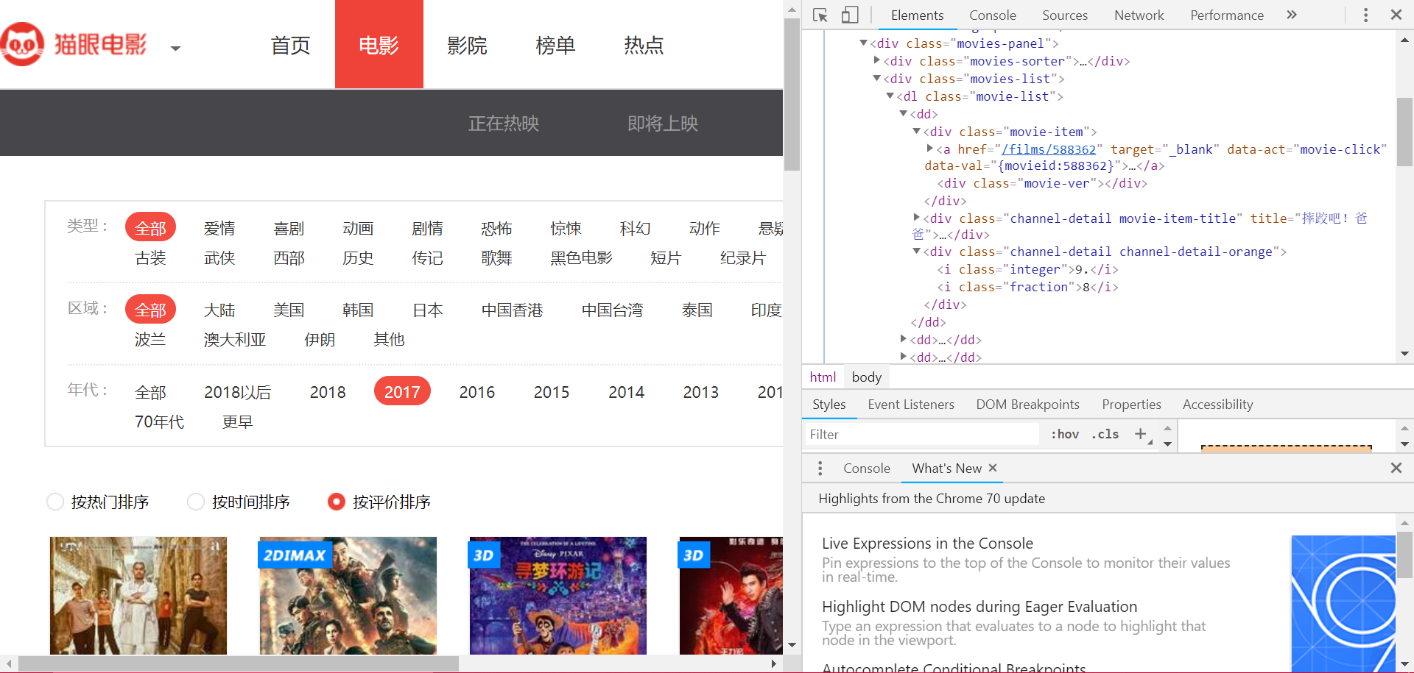
Crawl all the urls to the film’s home page, and save its grade and name.
Build Crawlers

Slide 11
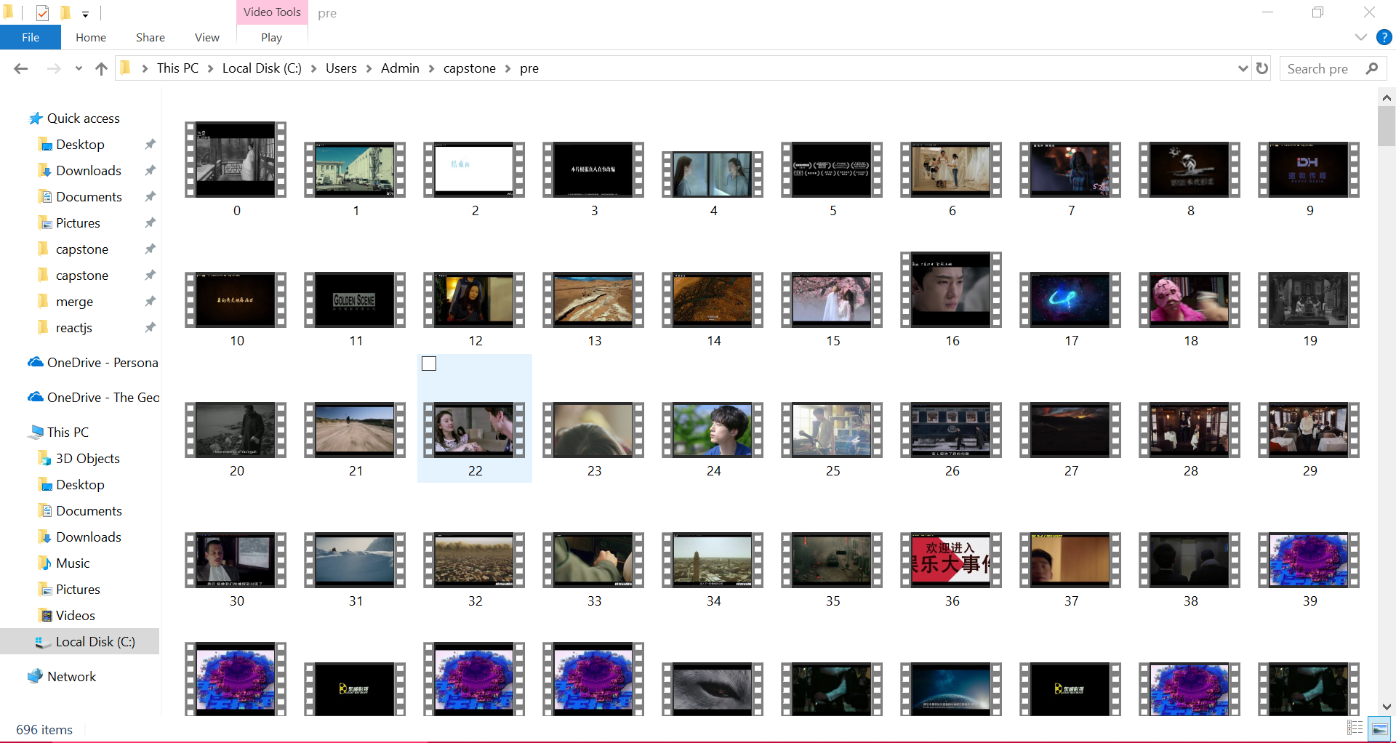
Download
Packages used:
urllib, re, os, pandas, time
The name of the downloaded prevue are from 0 by ordered.

Slide 12
Create empty folders
Packages used: os, sys
There are 203 films.
Generated 203 empty folders from name 0.
This is the pre step for copy & move.

Slide 13
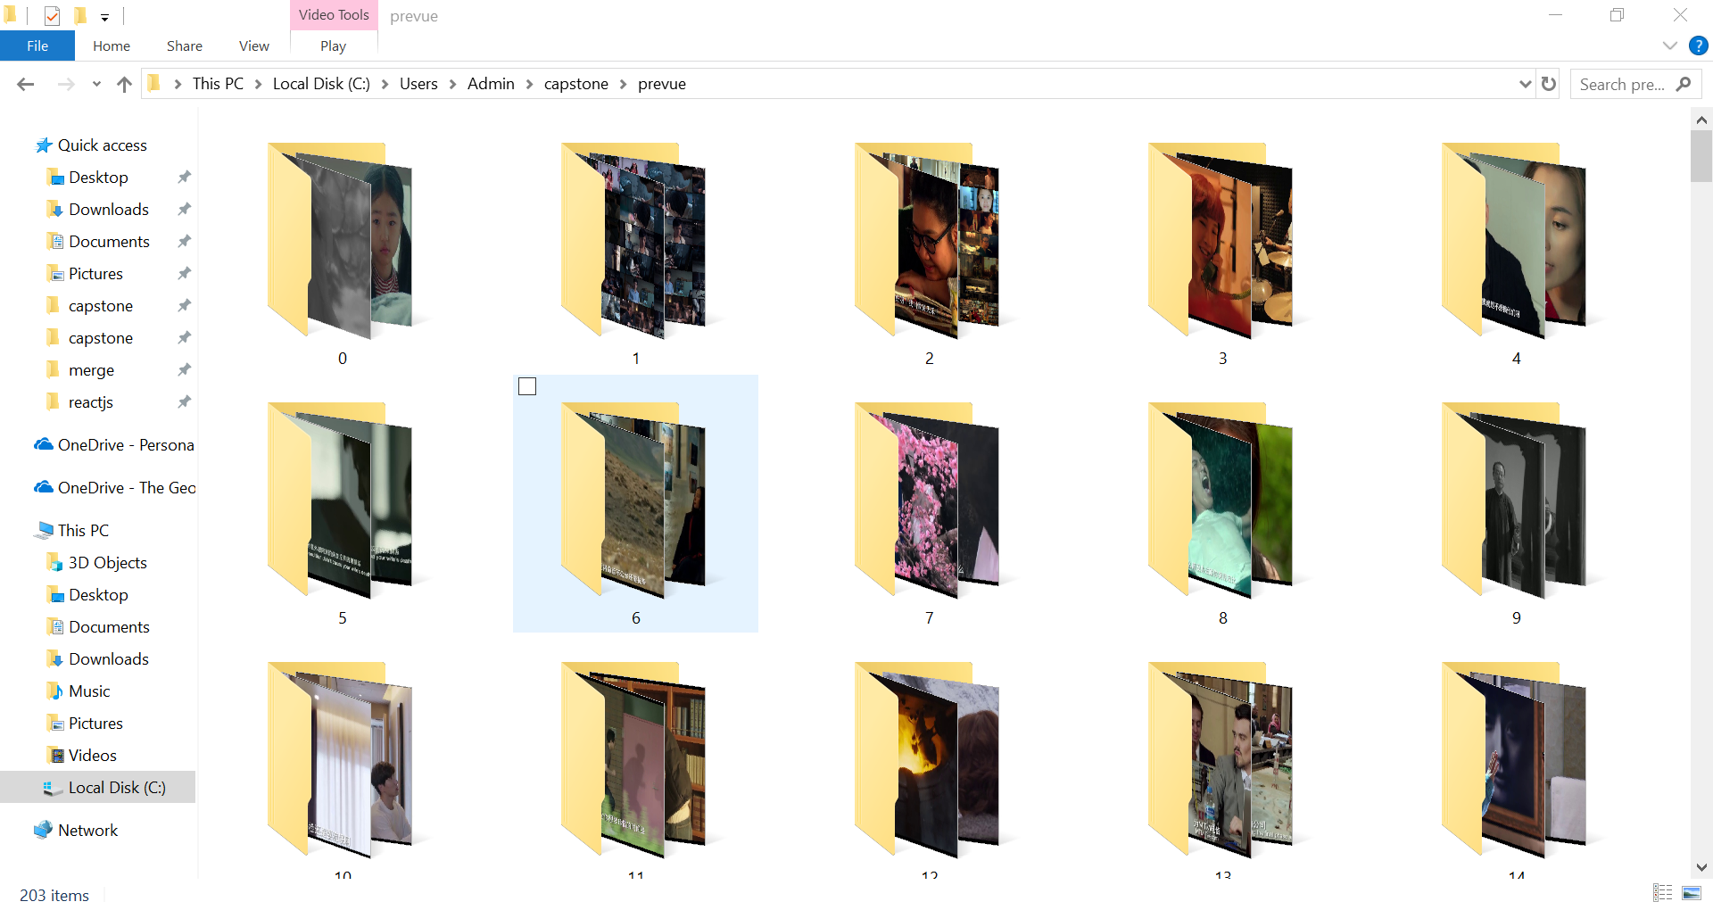
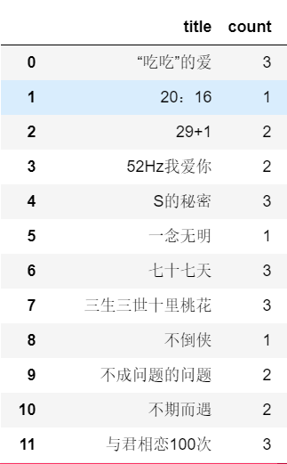
Copy & Move
Packages used: pandas, numpy, shutil, os
Generated the prevue amount of each film.
If the index equals to the folder’s name, then copy the number of the size of the prevue of the film into the folder.

Slide 14
Cut
Packages used:
cv2, pandas, _future_, shutil, os
Traverse the dir and cut all the videos by 2 sec.

Slide 15
Rename all the pics
It will make things easier when traverse the pics.
All the pics in each folder will start with 0.

Slide 16


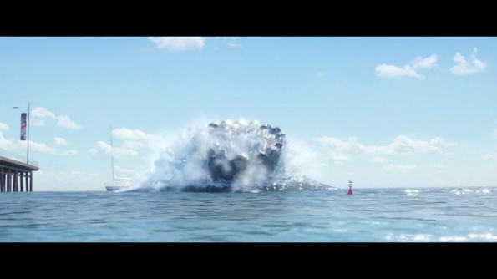
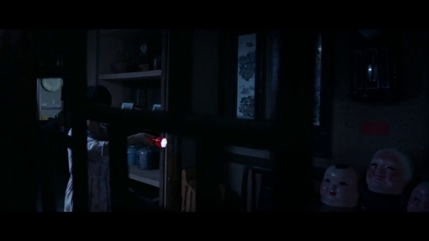
Crop & Filter
The pictures had black edges, or poor quality with almost black or white.

Slide 17
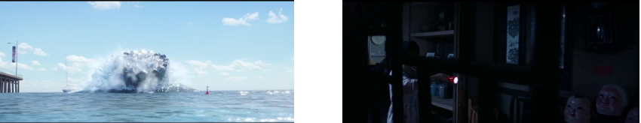

Crop & Filter
1. A function to cut all the black edges of all the pictures. (manually took an example in each folder to initialize and store the shape and size to cut in order to maintain the same shape and size.)
2. A function to estimate whether the picture was too black or too white. (had to double check the conditions of the remove black picture function in order to save those horror movies with almost every scene black.

Slide 18
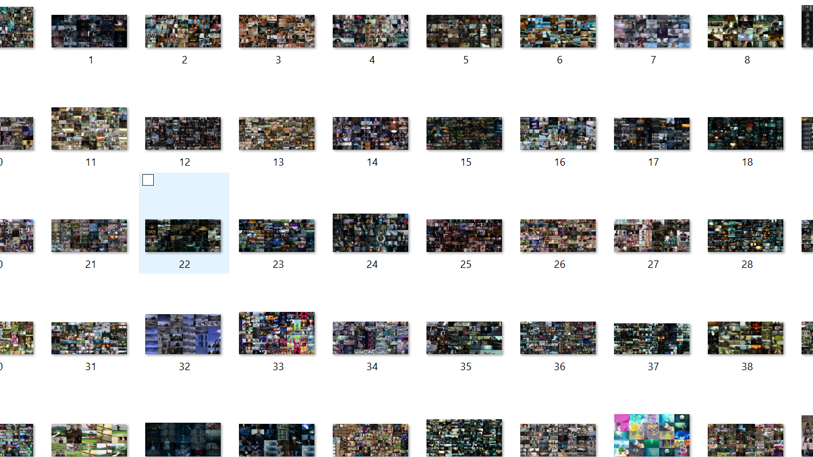
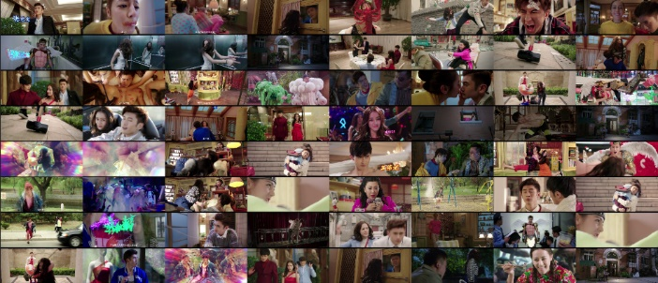

Merge pictures into one.
No more than 150 children pics in order to remain in the computational range.
Resize & reshape – 600*400

Slide 19
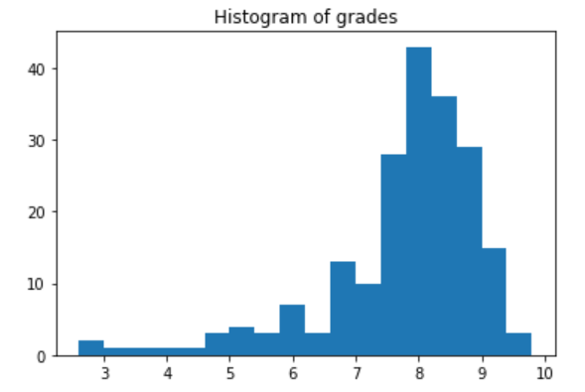
KNN – data processing
Check the data distribution of rankings(grades)
Split the rankings into 5 levels
Level 0: grade lower than 6
Level 1: grade between 6 and 7
Level 2: grade between 7 and 8
Level 3: grade between 8 and 9
Level 4: grade higher than 9
Modify 3D data into 2D
Split data into training set(80%) and test set(20%)

Slide 20
KNN - model accuracy comparation
2D data |  | Average data
Brute | 0.33497536945812806 | brute | 0.5517241379310345
kd_tree | 0.4433497536945813 | kd_tree | 0.5566502463054187
ball_tree | 0.46798029556650245 | ball_tree | 0.5467980295566502

Slide 21
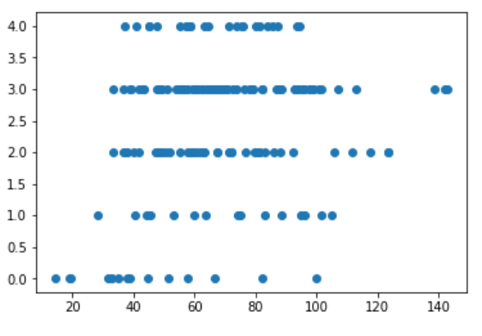
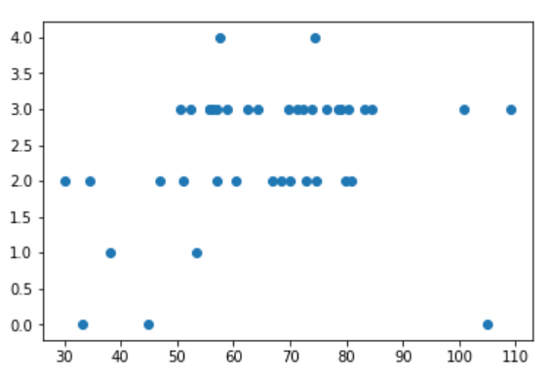
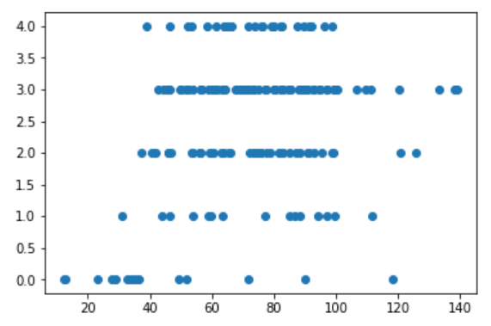
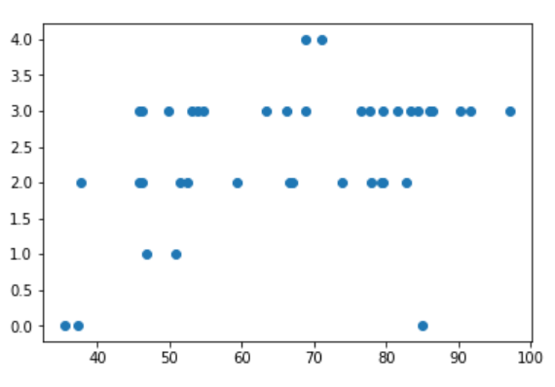
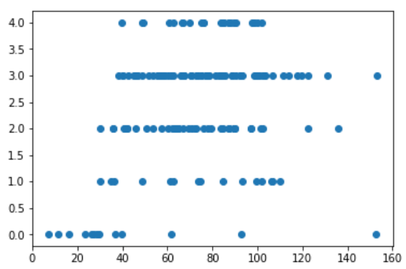
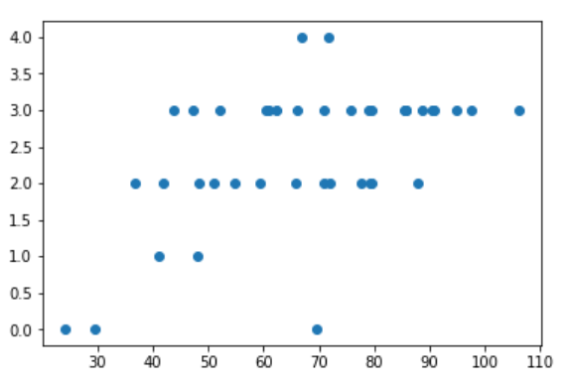
Tendency of colors
BGR | TRAIN SET | TEST SET
B
G
R

Slide 22
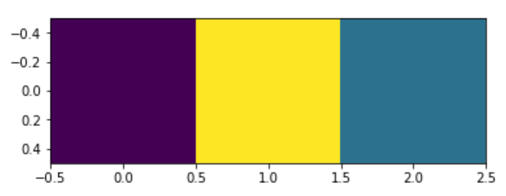
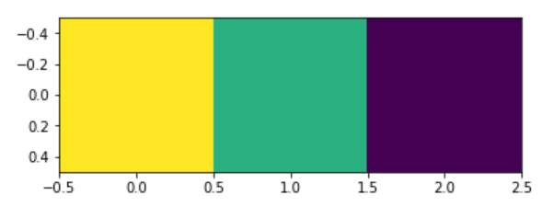
Compare the BGR of the highest ranking to the lowest ranking

Slide 23
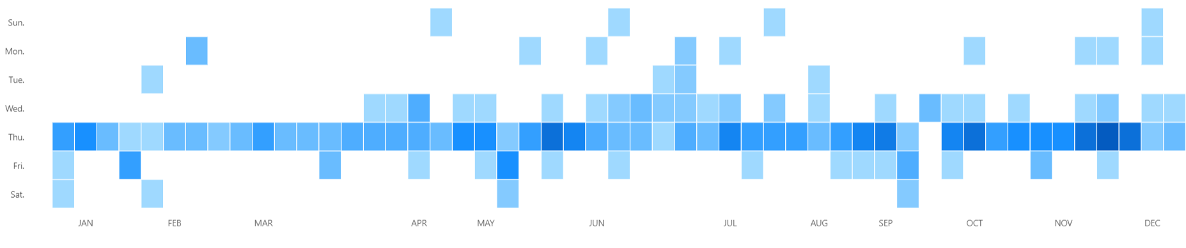
Data Visualization – based on bizcharts-react.js
Release by day
As showed in this graph, most of the films in 2017 launched on Thursday. The darker the color the more released films on that day.

Slide 24
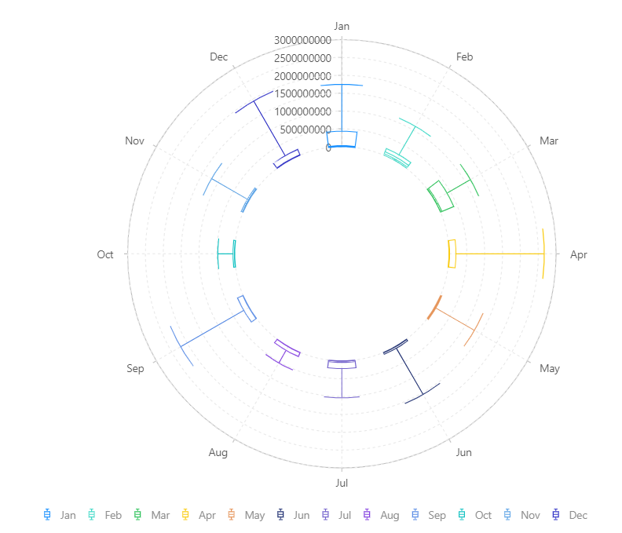
Data Visualization – based on bizcharts-react.js
Box-office by day
As showed in the graph, each month had some dark houses. Most of the films had the box-office around ￥500,000,000(around $71,430,000).

Slide 25
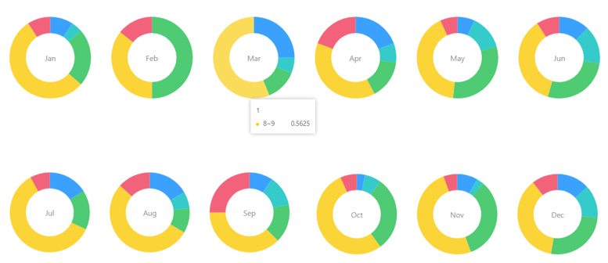
Data Visualization – based on bizcharts-react.js
Ranking by month(rankings modified in levels)
The visualization of this graph matched the histogram in former slide. Most of the film got their rankings in 8~9. The funny thing is all the films in Feb had a ranking exceeded score 7. Spring Festival was in that month, it is called Lunar New Year Movie Season, similar to the Christmas Movie Season in the US, maybe the entertainment companies had to think twice before release that time. Big companies with best movie would try their best to earn more money. Small companies might not even have a chance to scheduled their film in the cinema.

Slide 26
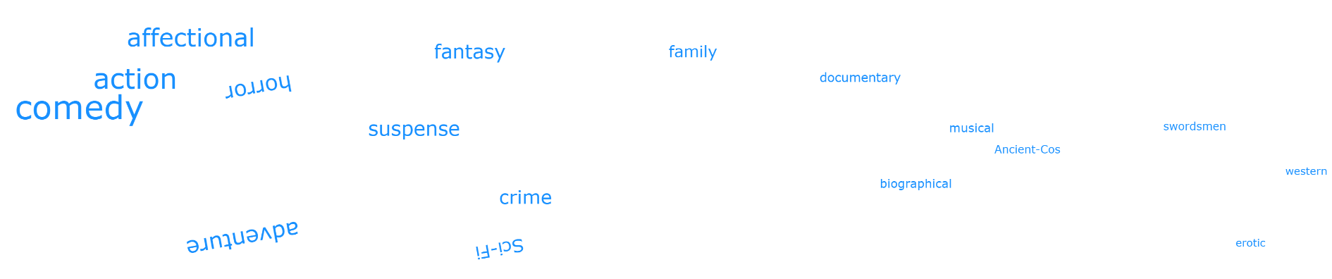
Data Visualization – based on bizcharts-react.js
Word cloud of all the genres.
The most released during 2017 was comedy movie. Everyone wants to be happy. So comedy movies always have a big share of the market. Action movie and affectional movie are also always the red hot topics.

Slide 27
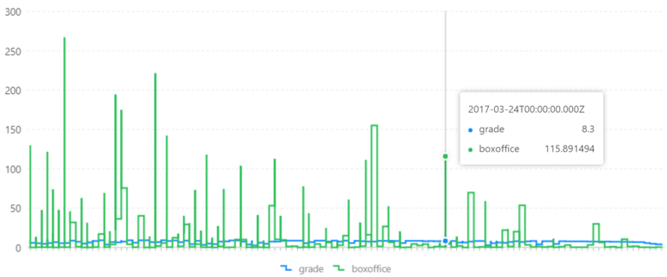
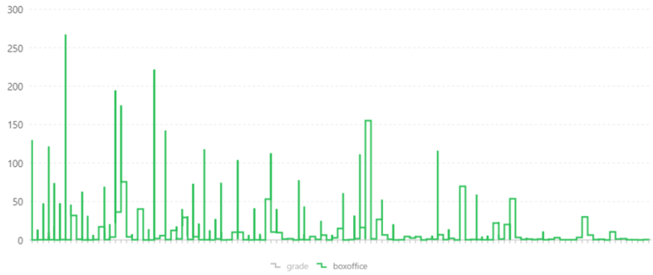
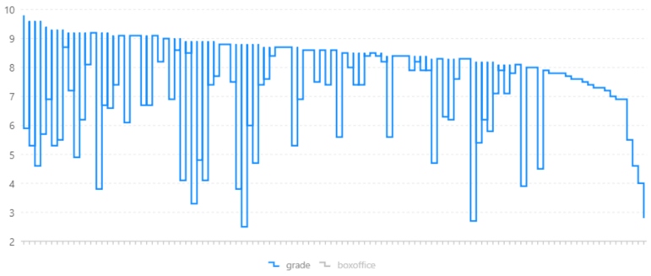
Data Visualization – based on bizcharts-react.js
Based on the graphs, there should be relationships between grade(ranking) and box-office. The higher ranking the films has, leads to a better box-office.

Slide 28
Problems & limitations
First of all, there were no ready-to-use datasets. And I had to face the threat to be blocked when crawling the data.
At the very beginning, the topic was to explore the relationship between color-tone and its box-office. But, after crawled the data, the problem arose. The box-office had a great discrepancy between the maximum and the minimum. Therefore, it would be hard to build levels based on box-office.
The amount of raw data was huge. With a huge amount, it was hard to control the qualities that were needed in the project. And there were even more missing values that had to be dropped.
Although the raw data had a significant amount. The final data were only 203 merged pictures. This leaded to the limitation to build models. At least 1000 films should be collected.

Slide 29
Think again about this project
To build a color-tone with genre model will be more useful. The directors and productors can used the best predicted color-tone to fit their movies.
The movies with the best color-tone will perform better even more than the stories told.
If a model could predict the trend color, it will show the commercial opportunities.

Slide 30
Thank You!

